Slide 1
A Schematic Of the Product
Raise temperature to the melting point of glue
Inbuilt lithium battery power supply
Gun chamber heated
Solid glue stick turns to fluid
Push glue stick
Fluid glue come out from nozzle
Store glue stick
Raise air pressure
Pull trigger
Drive needle valve
Flow of forces of energy
Uncover child lock
Flow of material
Flow of signals or data

Slide 2
Cluster the Elements of the Schematic
Battery type
Heat mechanism
Raise temperature to the melting point of glue
Inbuilt lithium battery power supply
Gun chamber heated
Solid glue stick turns to fluid
Glue stick grip mechanism
Glue rate controlling
Push glue stick
Fluid glue come out from nozzle
Store glue stick
Trigger
Raise air pressure
Pull trigger
Drive needle valve
Child lock
Uncover child lock

Slide 3
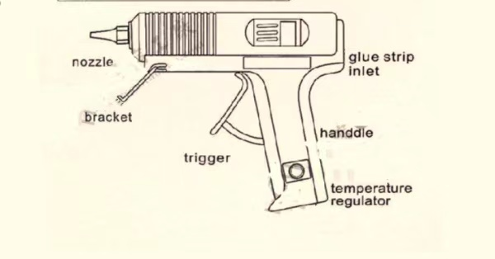
Rough Geometric Layout
Note: It’s just a sketch of glue gun I found online. Please re-draw it with a drawing software or hand. We also need a sketch for the gun chamber, which should contain insulation sleeve, glue stick, etc.

Slide 4
Identify the Fundamental and Incidental Interactions

